Slide 1





An Indirect Approach to Promoting STEM Education
Joy Davies
Mentor: Dr. Barron Orr
NASA Space Grant Symposium
April 17, 2010
University of Arizona

Slide 2


The Problem
  Significant national decline in US graduates with STEM related degrees
in.lcms.org
Traditional classroom model needs to be augmented somehow
http://www.bvblackspin.com/2009/12/09/in-detroit-whos-scoring-lower-students-or-parents/
www.darpa.mil/IPTO/solicit/baa/RA-10-03_PIP.pdf

Slide 3
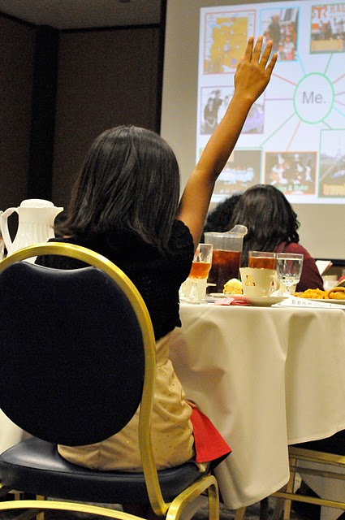
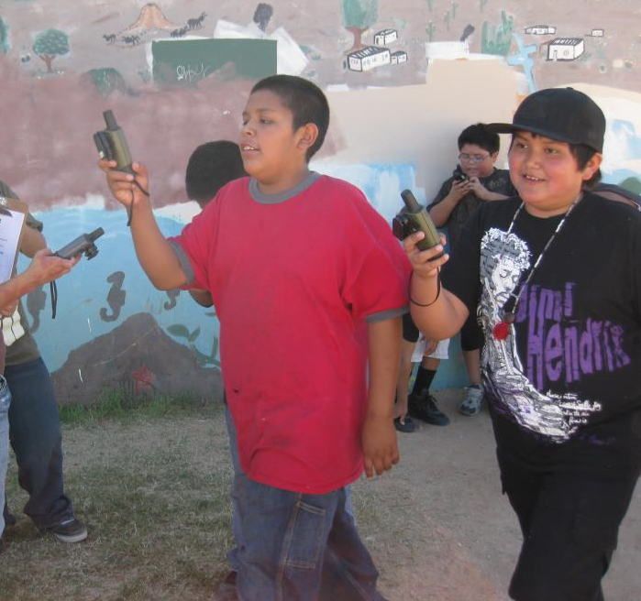

A Possible Solution
Working with the Pascua Yaqui tribe, we introduced
technology informally in after school programs
Tried to meld STEM learning around their interests.
Taken by Barron Orr
Taken by Kostya Nakazny
http://www.inspiredbyeducation.com/wp-content/themes/intel/images/logo_computerClubhouse.gif
http://www.imls.gov/applicants/samples/Pascua%20Yaqui%202009%20Enhancement.pdf

Slide 4
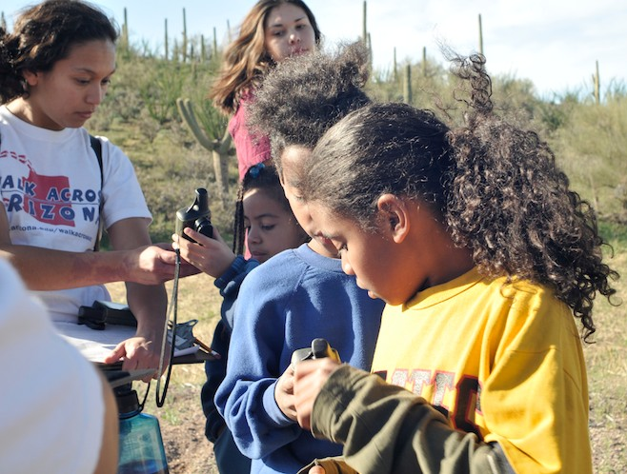
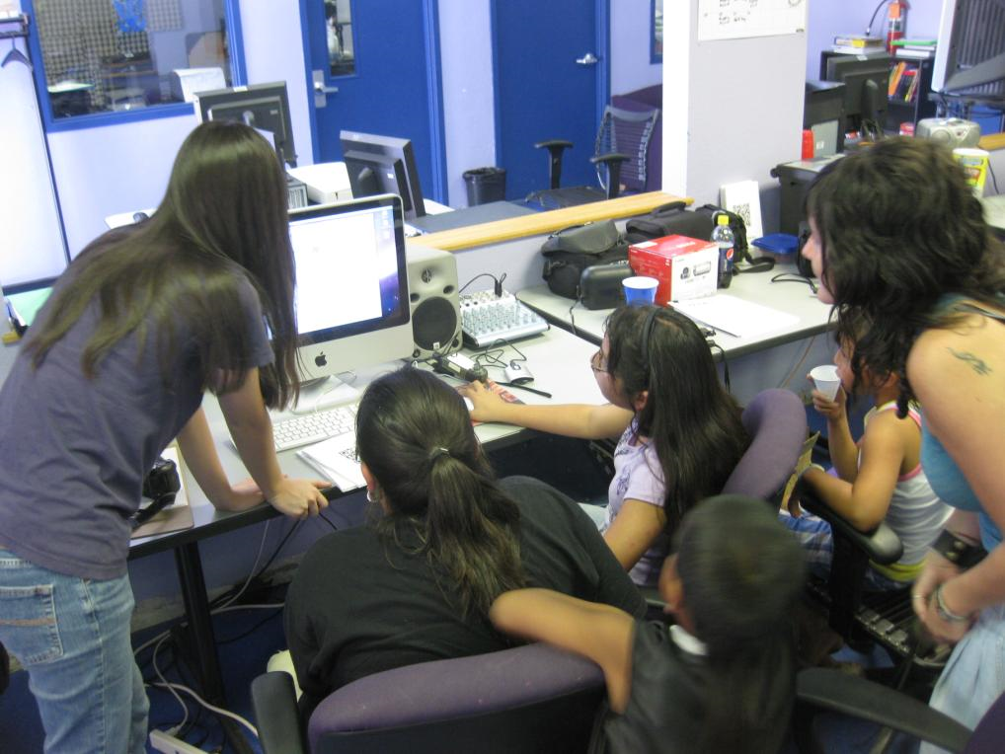
Methods
Interactively working with youth
Ongoing weekly meetings about project development
Working in a capacity building role with young adult program leaders
Taken by Kostya Nakazny
Taken by Barron Orr

Slide 5
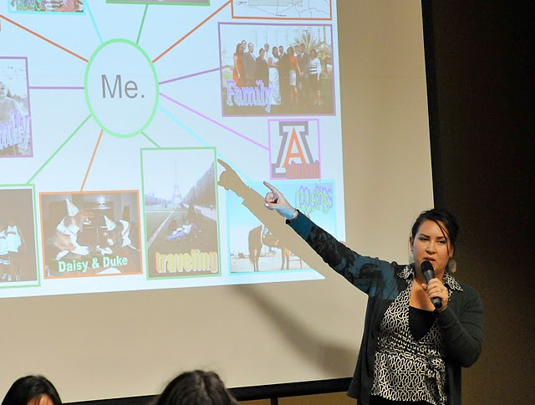
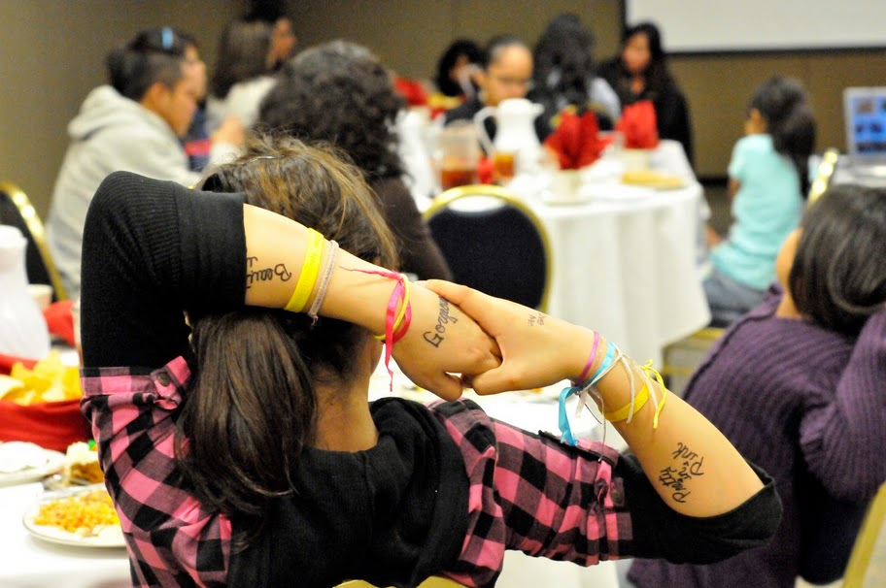
Pascua Yaqui Girls' Day Event
  Girls’ Day after school program
  Invited fashionable, successful Native American women to a formal dinner with all the girls' day participants
  Served as a kickoff to the e-mentoring program
Taken by Kostya Nakazny
Taken by Kostya Nakazny

Slide 6
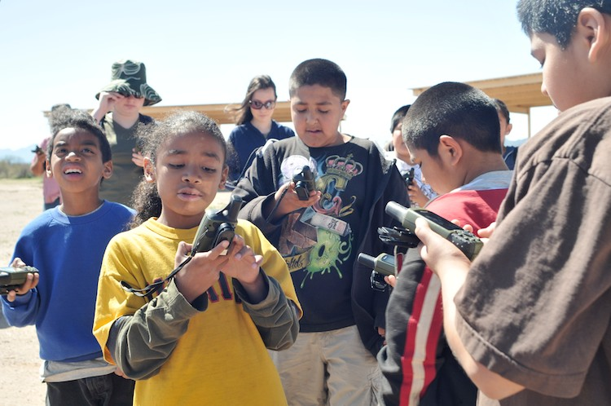
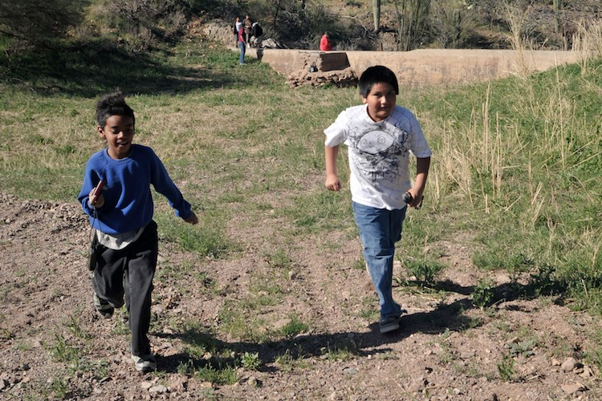
Tortuga Ranch Civic Engagement Project
  Introduced GPS and mapping technology to youth looking to explore their environment
Took lots of pictures and waypoints
Taken by Kostya Nakazny
Taken by Kostya Nakazny

Slide 7
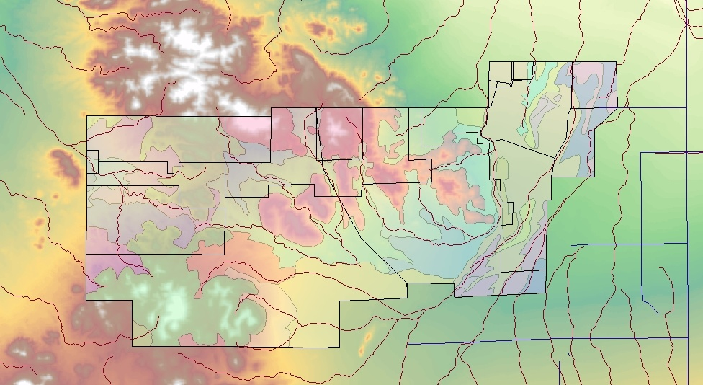
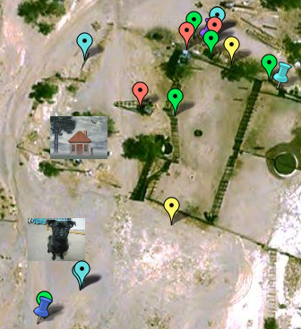
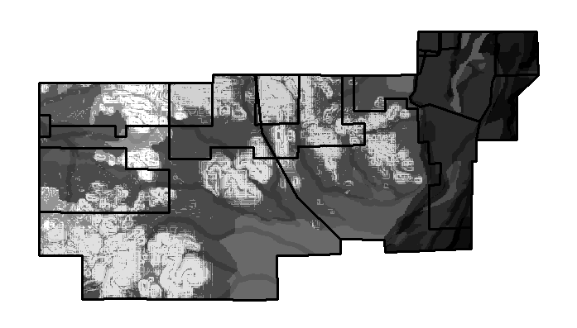
Introducing STEM Applications:
Satellite Imagery and Determining Land Suitability through GIS
http://maps.google.com/maps/ms?ie=UTF8&hl=en&msa=0&msid=113516039571418718338.00046ead3d06acaf49634&t=h&z=12

Slide 8
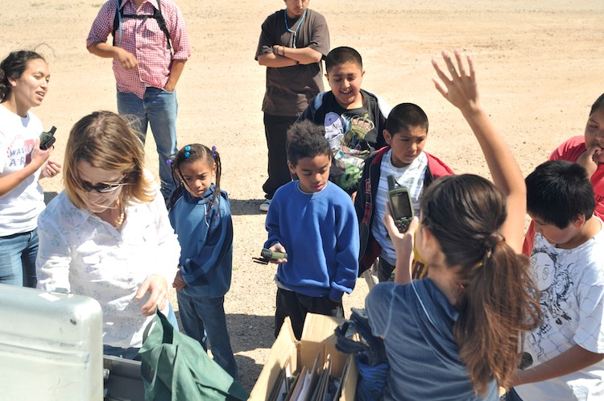
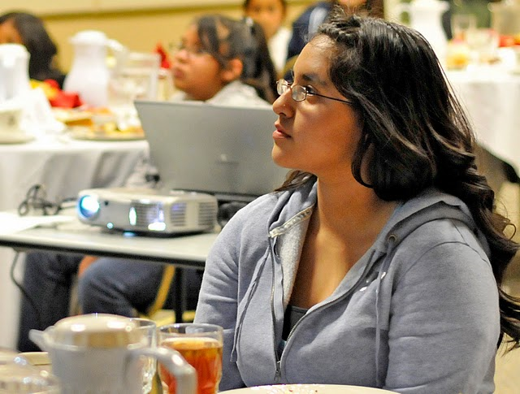
Impacts
Created youth-adult partnerships
Increased engagement with science
Youth empowerment
Taken by Kostya Nakazny
Taken by Kostya Nakazny

Slide 9
Thank You
  Dr. Barron Orr
  Jeanne Choquehuanca
  Kristin Wisneski
  Gilbert Valenzuela
  Astrid Balderrama
  Mario Valencia

